Slide 1
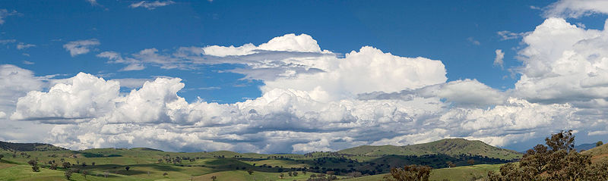
INGI2145: CLOUD COMPUTING (Fall 2015)
The Cloud
17 September 2015
Lecture slides adapted from Upenn NETS212 by A. Haeberlen, Z. Ives Reproduced with permission

Slide 2
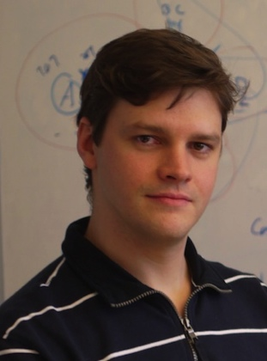
Welcome!
My name: Marco Canini
Faculty member at INGI
Research interests:
Large-scale Distributed Systems
Cloud Computing
Computer Networks
See also: http://perso.uclouvain.be/marco.canini/

Slide 3
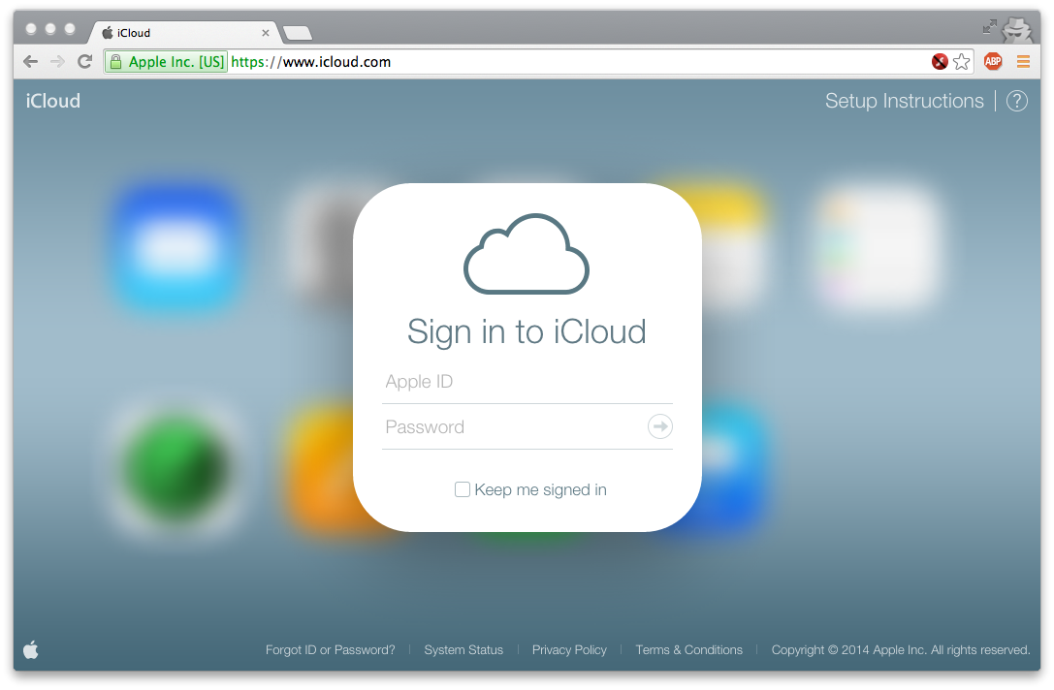
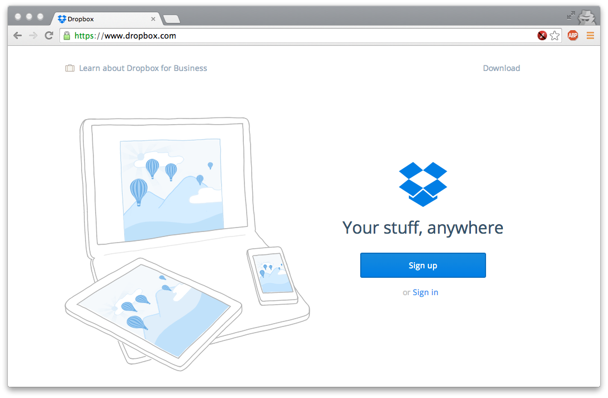
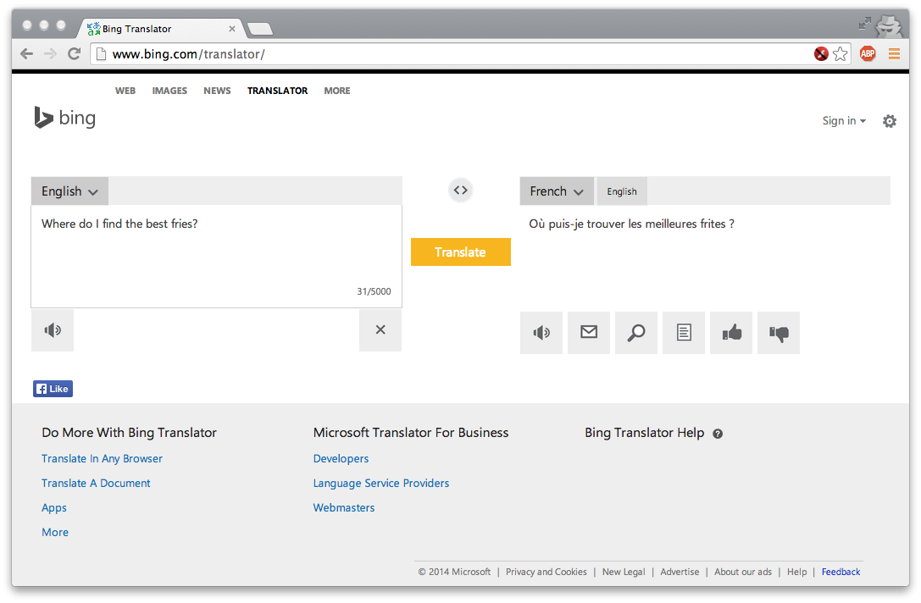
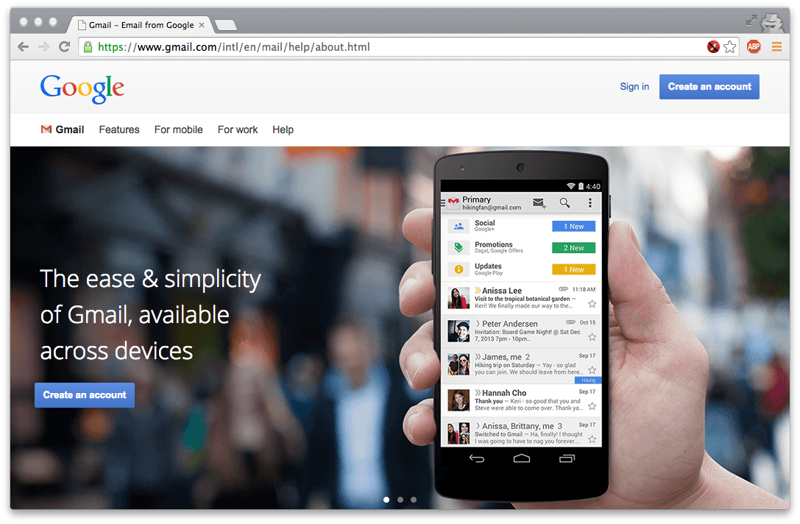
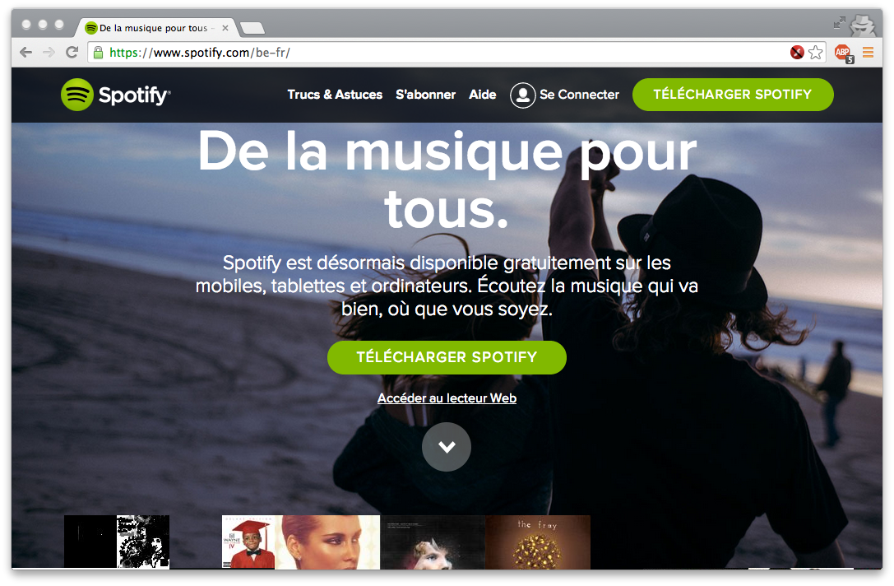
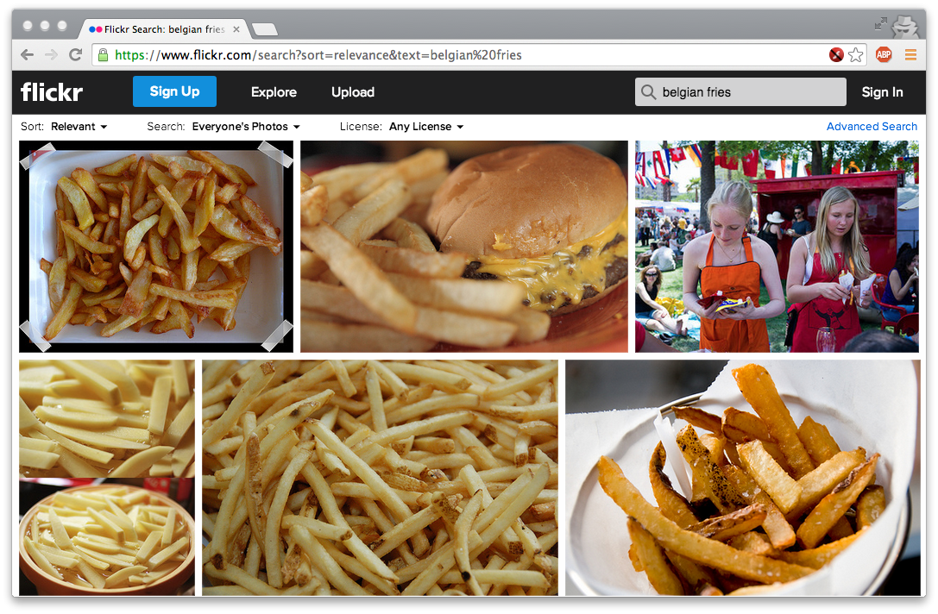
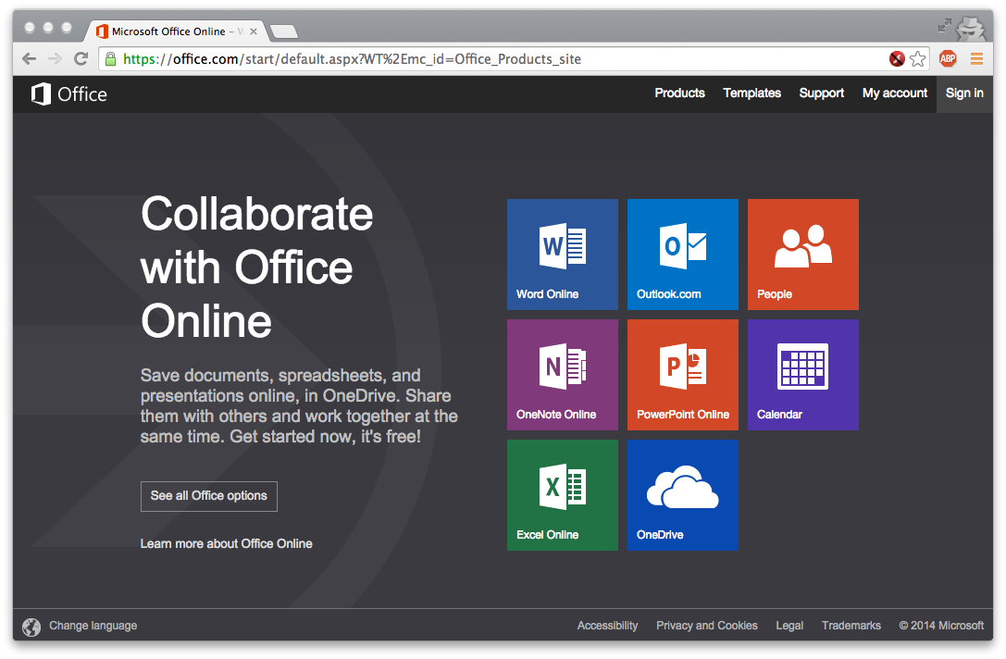
Have you used 'the cloud' before?

Slide 4
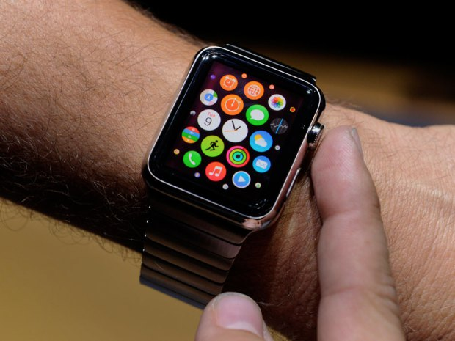
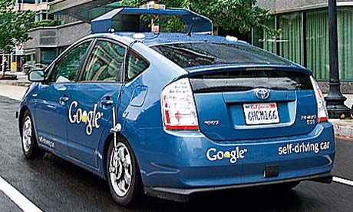
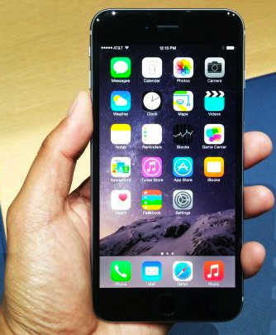
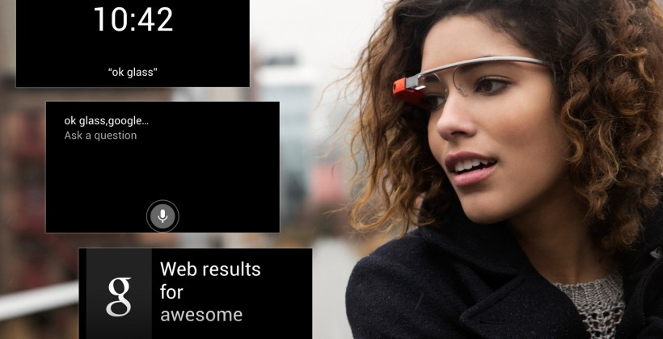
The cloud in your pocket and beyond
Notes:
http://static.guim.co.uk/sys-images/Guardian/Pix/pictures/2013/4/10/1365602225561/Self-driving-car-008.jpg
http://wpmedia.business.financialpost.com/2014/09/apple-watch-features-apps.jpg?w=620
http://cdn.slashgear.com/wp-content/uploads/2013/02/google_glass_ui_leak_hero-820x420.jpg
http://oyster.ignimgs.com/wordpress/stg.ign.com/2014/09/0909141210a_1-720x405.jpg

Slide 5
Why should I care?
Understand what’s underneath the Cloud
How does it work? What are its strengths? Its shortcomings?
Technologies: virtualization, MapReduce, key-value store, NoSQL, Ajax, ...
Understand the underlying principles
How do you build something that is so scalable, robust, etc.?
Lots of clever algorithms needed - very different environment!
Be able to use the right approach when designing new protocols and web systems
How would you go about building the next Facebook?
Need to scale, be efficient, avoid failures, ...

Slide 6
Why should I care? (continued)
Gain practical experience with cloud technologies
Often, the best way to understand it is to build one yourself
In this course, you will build on top of Amazon Web Services and Apache Hadoop, Spark, and more…
Understand the impact on society
Vulnerabilities, privacy concerns, data survivability, ...
Need to understand the current state of the technology!
Anticipate what’s possible in the future

Slide 7
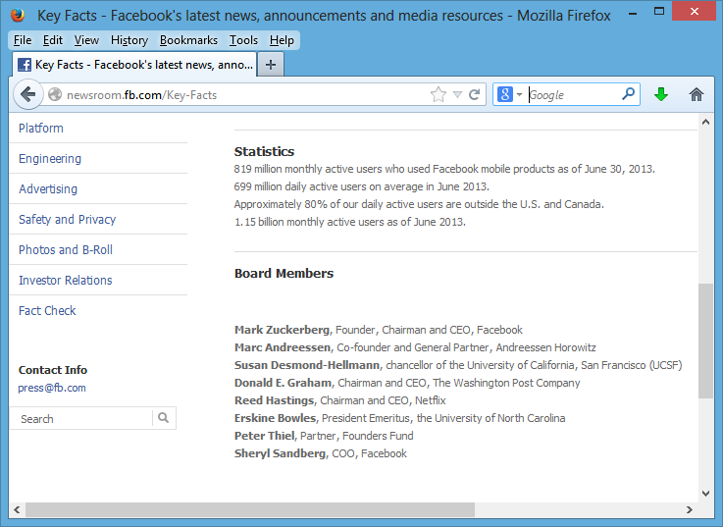
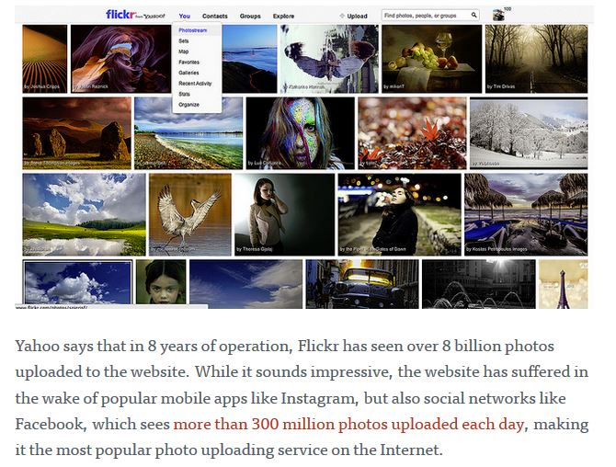
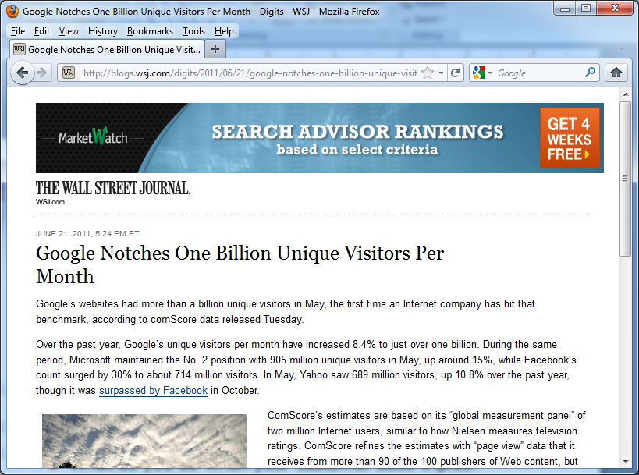
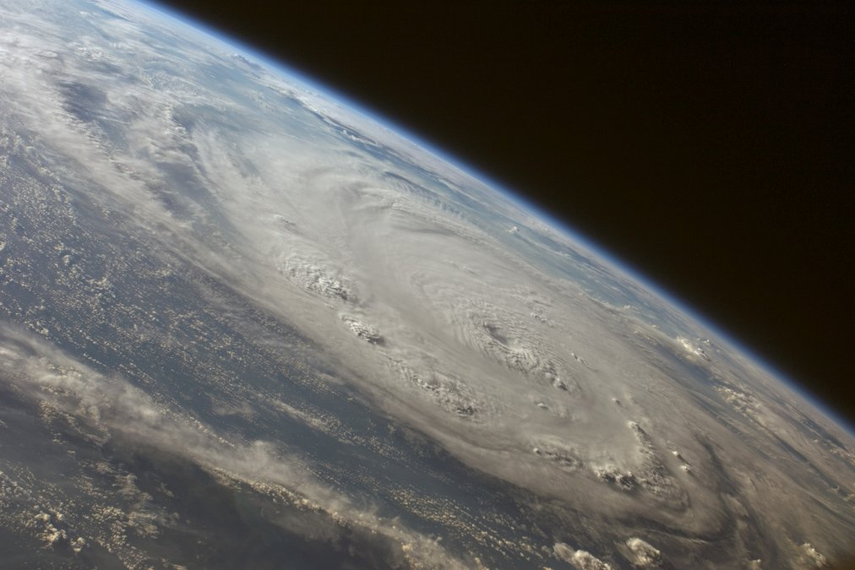
How big is the cloud?

Slide 8
Data-centric computing
Trend towards data-centric computing
Two words: "Big data"
Today’s currency on the Internet is data!
You “pay” for using Google, Facebook, etc. by letting them record your every action, link, search, etc.
But data’s value is not just economic:
It allows us to better answer questions, understand what’s important, validate hypotheses about social interactions, …
Example: Online Social Network research

Slide 9
Data-centric computing is pervasive
Today, Google and Friends aren't the only "Big Data" players
Not just Google & friends - banks, financial firms, academia, the government, companies, military, startups, ...
All need to store and analyze huge data volumes
This is being enabled with a new generation of hardware “hosting” services – “the cloud” – and programming models

Slide 10
What is INGI2145 about?
How do we build effective data-centric applications, and serve them to the entire Internet?
You’ve learned procedural programming on a single machine – we’ll look at data-centric programming across thousands of machines
We’ll understand the issues in breaking up problems, global coordination, failures, and so on
We’ll study many of the systems and algorithms used by real Internet services
How do we take advantage of “the cloud” – the vision of computing as a utility (like the power grid)?
You’ll understand what lies underneath the cloud computing hype, and how to use the cloud
You’ll build real projects hosted “on the cloud”

Slide 11
Towards understanding a larger trend
Internet services are increasingly integrated into the fabric of our society
Communication – Twitter, Facebook, Skype, IM, …
Media – iTunes, Spotify, Netflix, …
Markets – Amazon, eBay, stock exchanges, advertising
Utilities, commodities – smart power grids, exch. markets
Cloud computing likely to have profound implications on economical, social, ethical and legal matters
Data-centric, quantitative methods are revolutionizing advertising, sales but also science

Slide 12

Plan for today
Introduction
Course logistics
The Cloud
NEXT

Slide 13
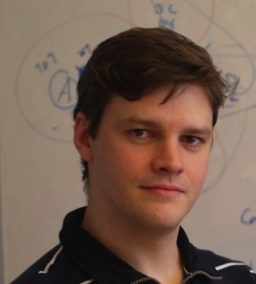
Course Staff
Marco Canini
Réaumur A-049, x7-4832
Bilal (TA)
Réaumur A-027
Thanh Nguyen (TA)
Réaumur A-043

Slide 14
Course website
https://sites.google.com/site/uclingi2145/
All official communication is there

Slide 15

Course discussion group
We will be using for discussions related to this course
Examples: Questions about homework assignments
The TAs and I will read the posts and respond to questions
Piazza will also be used for
Announcements, e.g., cancelled classes (if necessary)
Supplemental materials, e.g., links to relevant papers
Corrections/clarifications, e.g., bugs in homework handouts
Please check the group frequently!
Please sign up at
https://piazza.com/uclouvain.be/fall2015/ingi2145
TODO
Notes:
TODO: check link

Slide 16
Lectures
Regularly Thursdays 14:00 to 16:00, BARB 00
Could exceptionally be on Fridays 8:30 to 10:30, BARB 21
Check online schedule often
Be on time!
Course slides published in the git repo at
https://github.com/mcanini/INGI2145-2015/
Most lecture have assigned readings
Must be prepared in time for the lecture
Evaluated as part of participation grade

Slide 17
Lab sessions
We will organize ~7-8 lab sessions
Complement the lectures with more practical information and hands-on exercises
A sketch solution of the exercises will be presented during the session
Labs on Fridays 8:30 to 10:30, BARB 21
Attendance is highly encouraged
First lab is tomorrow: intro to AWS!
Notes:
TODO: check number of labs

Slide 18
Homework assignments
We will organize 2-3 homework assignments
They are all mandatory
No extensions granted
Automatic lateness penalty applies: 10% deducted on the assignment grade for each day late or fraction thereof
If an assignment is 1 minute late, it is one day late
Start to work on them early
Do not wait until the last day before homework is due
Deploy and run code on Amazon EC2
But credit is limited. Don’t blow it up!
We will offer a standardized development system that is based on a virtual machine

Slide 19
The INGI2145 Virtual Machine
We will provide a virtual machine with the necessary software
Linux, Hadoop, Amazon CLI, …
Use with VMware Player, VirtualBox, etc.
Safe to experiment with
Standardized environment makes it easier to support
We will not support custom environments
Second lab session
Demonstrate how to provision the virtual machine through Vagrant and Puppet, or Docker

Slide 20
Grading
Final exam: 60%
Homework: 30%
Participation: 10%
Note: Homework grade and participation grade carry to the second examination session (September) as they cannot be repeated
Grading policy is the same for first and second examination session

Slide 21
Participation counts towards grade
Prepare mandatory readings for classes and complete paper evaluation quizzes
Engage in discussion, make insightful questions or comments during class
(also on Piazza)
May organize in-class quizzes on material covered in prior classes

Slide 22
Policies: Collaboration
All assignments must be done individually
All the code you submit has to be your own
Only exception: Code we have provided or explicitly authorized
UCL's regulations applies
No cheating, plagiarism, fabrication, multiple submissions, gaining an unfair advantage, or facilitating (!) academic dishonesty
It's not worth it!! Penalties can be severe: http://www.uclouvain.be/enseignement-reglements.html
Zero tolerance policy to ensure fairness
We will use various tools to actively look for cheating

Slide 23

Policies: Collaboration
Yes
No
Can we work on assignments together?
Can I discuss the assignment with others (in general terms)?
Can I use code I copied from the web?
Can I ask questions about the assignments on Piazza?
I just happened to leave my password on my table, and XYZ just happened to find it. Will I be penalized for this?
Yes
No
Yes
No
Yes
No
Yes
No

Slide 24
Expected 'payoff'
You will acquire a set of skills that is in very high demand right now
At Google, Facebook, and at many other places
You will gain interesting insights
You will have a good basis for other courses

Slide 25
A disclaimer…
This is a “bleeding edge” course!
UCL is one of a handful of places offering these topics
The subject of this course is still evolving: no established curriculum, no classical textbooks yet
Some of the material in the course will result in hair loss
Debugging distributed code is hard!
We will be using some immature technology
We will do the best we can to smooth over the bugs
I hope it will be a fun course, though…
… and an interesting one!

Slide 26
Plan for today
Introduction
Course logistics
The Cloud
NEXT

Slide 27
Plan for today
Computing at scale
The need for scalability; scale of current services
Scaling up: From PCs to data centers
Problems with 'classical' scaling techniques
Utility computing and cloud computing
What are utility computing and cloud computing?
Evolution of software business models
What kinds of clouds exist today?
What kinds of applications run on the cloud?
Virtualization: How clouds work 'under the hood'
Some cloud computing challenges

Slide 28
How many users and objects?
Flickr has >8 billion photos
Facebook has 1.15 billion active users
Google is serving >1.2 billion queries/day on more than 27 billion items
>2 billion videos/day watched on YouTube

Slide 29
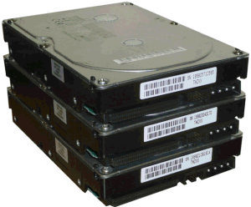
How much data?
Modern applications use massive data:
Rendering 'Avatar' movie required >1 petabyte of storage
eBay has >6.5 petabytes of user data
CERN's LHC will produce about 15 petabytes of data per year
In 2008, Google processed 20 petabytes per day
German Climate computing center dimensioned for 60 petabytes of climate data
Google now designing for 1 exabyte of storage
NSA Utah Data Center is said to have 5 zettabyte (!)
How much is a zettabyte?
1,000,000,000,000,000,000,000 bytes
A stack of 1TB hard disks that is 25,400 km high
25,400 km

Slide 30
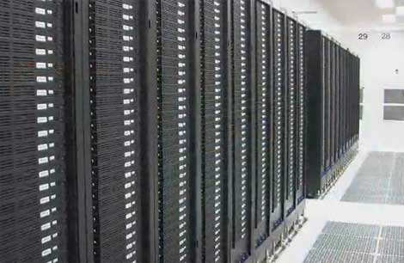
How much computation?
No single computer can process that much data
Need many computers!
How many computers do modern services need?
Facebook is thought to have more than 60,000 servers
1&1 Internet has over 70,000 servers
Akamai has 95,000 servers in 71 countries
Intel has ~100,000 servers in 97 data centers
Microsoft reportedly had at least 200,000 servers in 2008
Google is thought to have more than 1 million servers, is planning for 10 million (according to Jeff Dean)

Slide 31
Why should I care?
Suppose you want to build the next Google
How do you...
... download and store billions of web pages and images?
... quickly find the pages that contain a given set of terms?
... find the pages that are most relevant to a given search?
... answer 1.2 billion queries of this type every day?
Suppose you want to build the next Facebook
How do you...
... store the profiles and photos of over 1 billion users?
... avoid losing any of them?
... find out which users might want to be friends?
Stay tuned!

Slide 32
Plan for today
Computing at scale
The need for scalability; scale of current services
Scaling up: From PCs to data centers
Problems with 'classical' scaling techniques
Utility computing and cloud computing
What are utility computing and cloud computing?
Evolution of software business models
What kinds of clouds exist today?
What kinds of applications run on the cloud?
Virtualization: How clouds work 'under the hood'
Some cloud computing challenges
NEXT

Slide 33
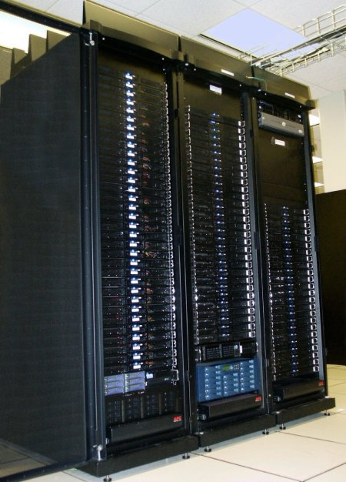
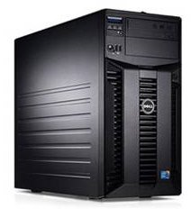
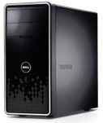
Scaling up
PC
Server
Cluster
What if one computer is not enough?
Buy a bigger (server-class) computer
What if the biggest computer is not enough?
Buy many computers

Slide 34
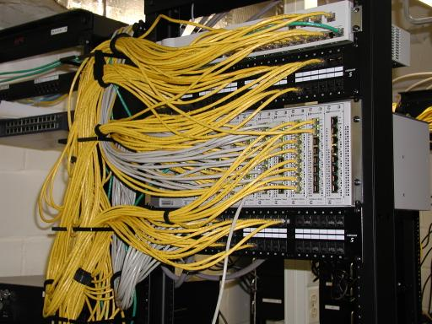
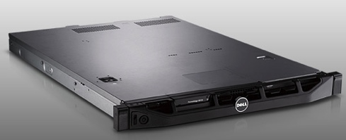
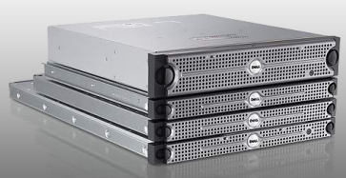
Clusters
Network switch (connects nodes with each other and with other racks)
Rack
Many nodes/blades (often identical)
Storage device(s)
Characteristics of a cluster:
Many similar machines, close interconnection (same room?)
Often special, standardized hardware (racks, blades)
Usually owned and used by a single organization

Slide 35
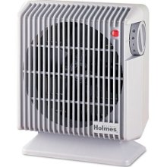
Power and cooling
Clusters need lots of power
Example: 140 Watts per server
Rack with 32 servers: 4.5kW (needs special power supply!)
Most of this power is converted into heat
Large clusters need massive cooling
4.5kW is about 3 space heaters
And that's just one rack!

Slide 36
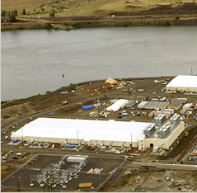
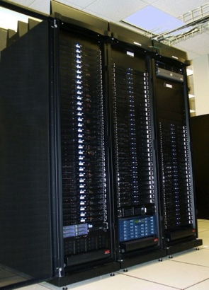
Scaling up
PC
Server
Cluster
Data center
What if your cluster is too big (hot, power hungry) to fit into your office building?
Build a separate building for the cluster
Building can have lots of cooling and power
Result: Data center

Slide 37
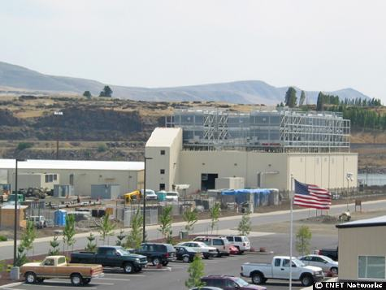
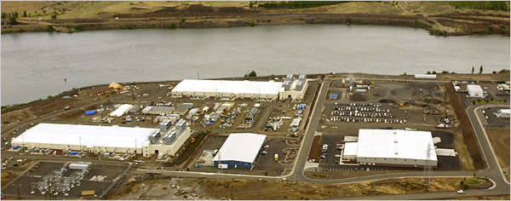
What does a data center look like?
Cooling plant
Data centers (size of a football field)
Google data center in The Dalles, Oregon
A warehouse-sized computer
A single data center can easily contain 10,000 racks with 100 cores in each rack (1,000,000 cores total)

Slide 38
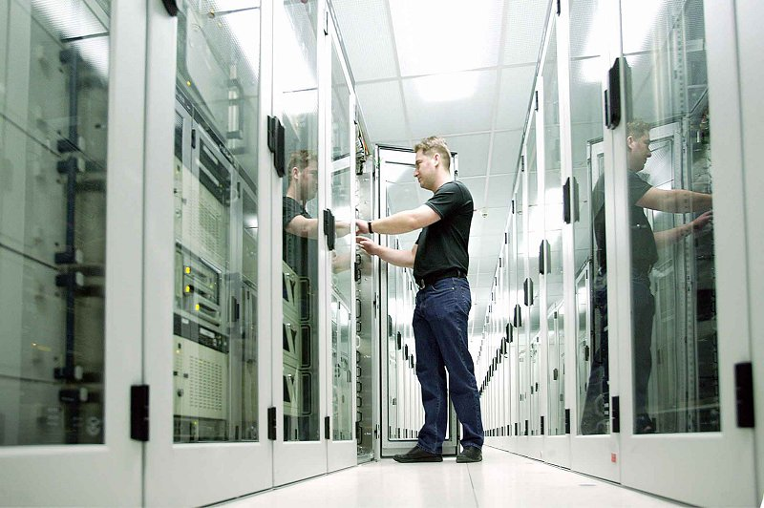
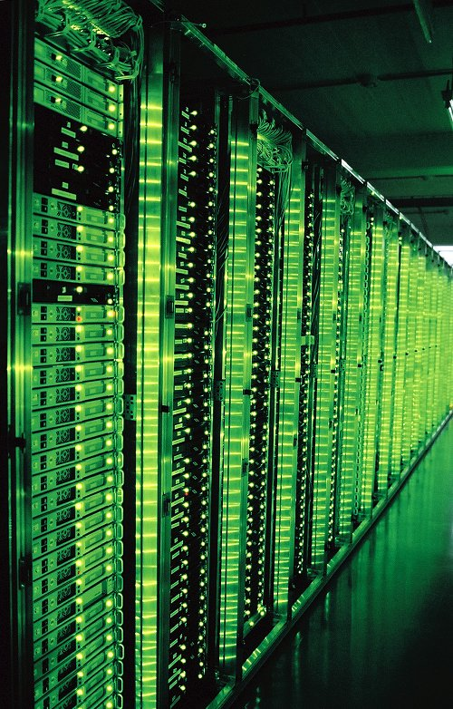
What’s in a data center?
Source: 1&1
Hundreds or thousands of racks

Slide 39
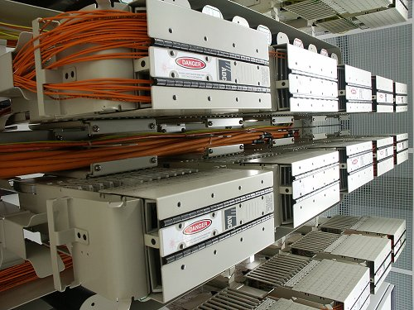
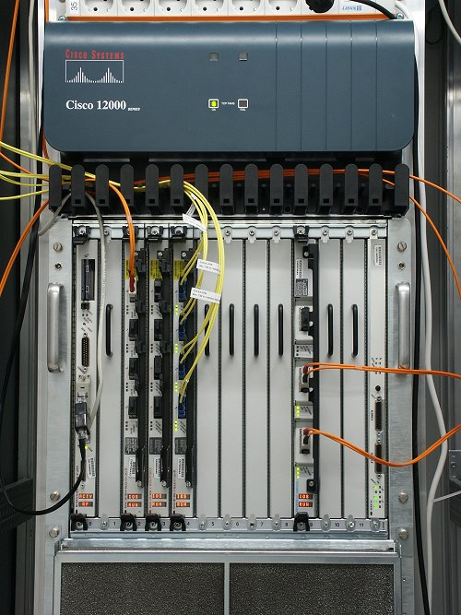
What’s in a data center?
Source: 1&1
Massive networking

Slide 40
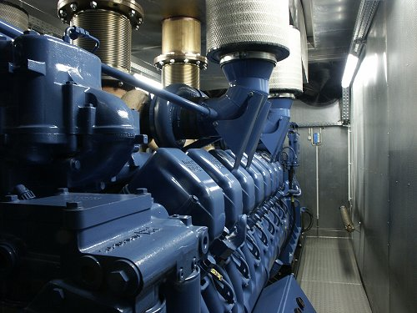
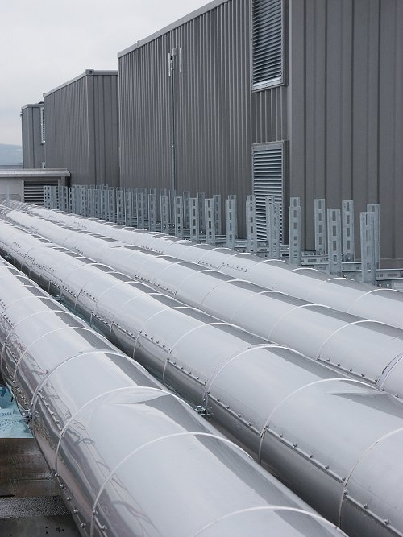
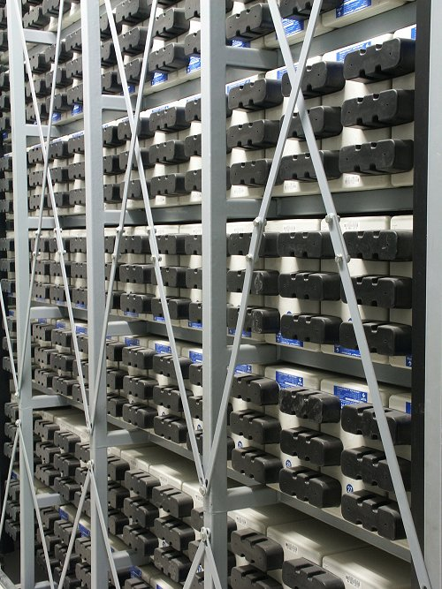
What’s in a data center?
Source: 1&1
Emergency power supplies

Slide 41
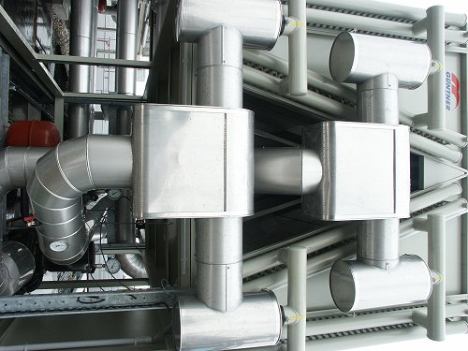
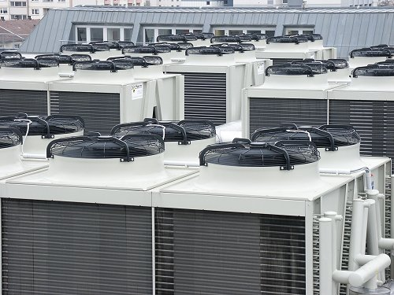
What’s in a data center?
Source: 1&1
Massive cooling

Slide 42
Energy matters!
Company | Servers | Electricity | Cost
eBay | 16K | ~0.6*10⁵ MWh | ~$3.7M/yr
Akamai | 40K | ~1.7*10⁵ MWh | ~$10M/yr
Rackspace | 50K | ~2*10⁵ MWh | ~$12M/yr
Microsoft | >200K | >6*10⁵ MWh | >$36M/yr
Google | >500K | >6.3*10⁵ MWh | >$38M/yr
USA (2006)
10.9M
610*10⁵ MWh
$4.5B/yr
Source: Qureshi et al., SIGCOMM 2009
Data centers consume a lot of energy
Makes sense to build them near sources of cheap electricity
Example: Price per KWh is 3.6ct in Idaho (near hydroelectric power), 10ct in California (long distance transmission), 18ct in Hawaii (must ship fuel)
Most of this is converted into heat → Cooling is a big issue!

Slide 43

Scaling up
PC
Server
Cluster
Data center
Network of data centers
What if even a data center is not big enough?
Build additional data centers
Where? How many?

Slide 44
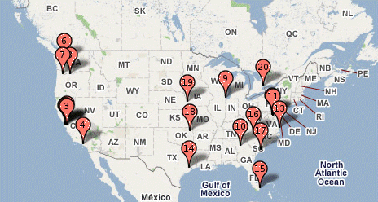
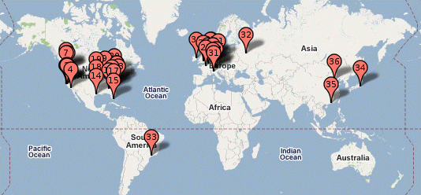
Global distribution
Data centers are often globally distributed
Example above: Google data center locations (inferred)
Why?
Need to be close to users (physics!)
Cheaper resources
Protection against failures

Slide 45
Plan for today
Computing at scale
The need for scalability; scale of current services
Scaling up: From PCs to data centers
Problems with 'classical' scaling techniques
Utility computing and cloud computing
What are utility computing and cloud computing?
Evolution of software business models
What kinds of clouds exist today?
What kinds of applications run on the cloud?
Virtualization: How clouds work 'under the hood'
Some cloud computing challenges
NEXT

Slide 46
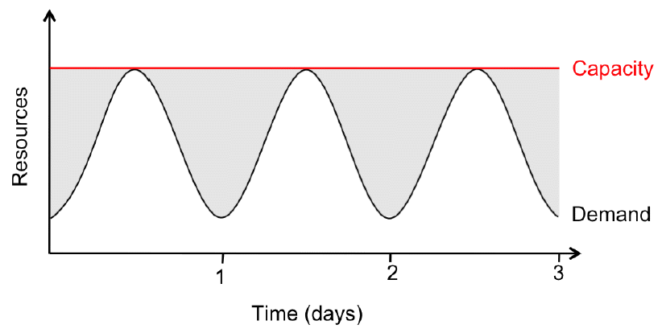
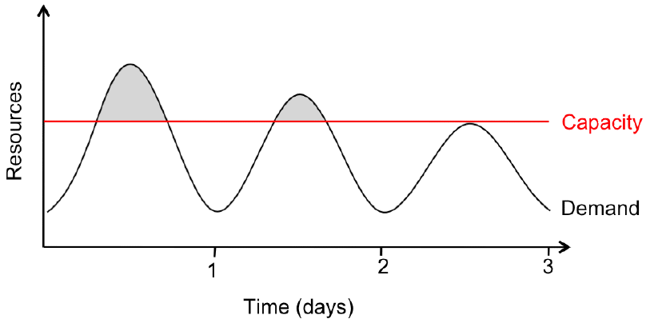
Problem #1: Difficult to dimension
Jobs cannot be completed
Dissatisfied customers leave
2x-10x
Provisioning for the peak load
Provisioning below the peak
Problem: Load can vary considerably
Peak load can exceed average load by factor 2x-10x [Why?]
But: Few users deliberately provision for less than the peak
Result: Server utilization in existing data centers ~5%-20%!!
Dilemma: Waste resources or lose customers!

Slide 47
Problem #2: Expensive
Need to invest many $$$ in hardware
Even a small cluster can easily cost $100,000
Microsoft recently invested $499 million in a single data center
Need expertise
Planning and setting up a large cluster is highly nontrivial
Cluster may require special software, etc.
Need maintenance
Someone needs to replace faulty hardware, install software upgrades, maintain user accounts, ...

Slide 48
Problem #3: Difficult to scale
Scaling up is difficult
Need to order new machines, install them, integrate with existing cluster - can take weeks
Large scaling factors may require major redesign, e.g., new storage system, new interconnect, new building (!)
Scaling down is difficult
What to do with superfluous hardware?
Server idle power is about 60% of peak → Energy is consumed even when no work is being done
Many fixed costs, such as construction

Slide 49
Recap: Computing at scale
Modern applications require huge amounts of processing and data
Measured in petabytes, millions of users, billions of objects
Need special hardware, algorithms, tools to work at this scale
Clusters and data centers can provide the resources we need
Main difference: Scale (room-sized vs. building-sized)
Special hardware; power and cooling are big concerns
Clusters and data centers are not perfect
Difficult to dimension; expensive; difficult to scale

Slide 50
Plan for today
Computing at scale
The need for scalability; scale of current services
Scaling up: From PCs to data centers
Problems with 'classical' scaling techniques
Utility computing and cloud computing
What are utility computing and cloud computing?
Evolution of software business models
What kinds of clouds exist today?
What kinds of applications run on the cloud?
Virtualization: How clouds work 'under the hood'
Some cloud computing challenges
NEXT

Slide 51
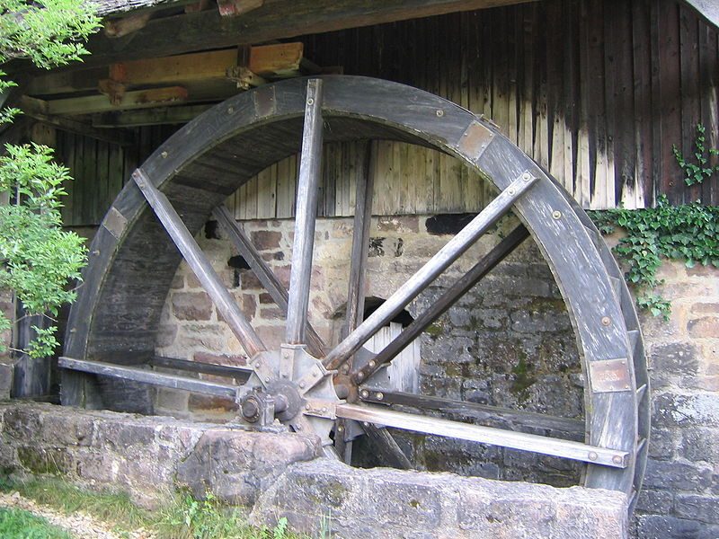
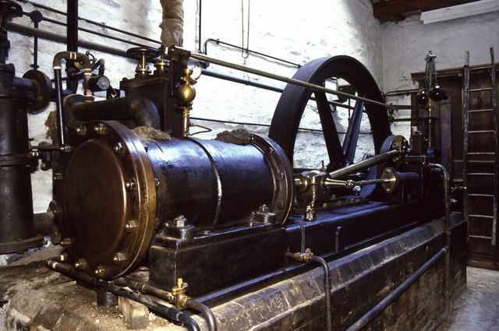
The power plant analogy
Steam engine at Stott Park Bobbin Mill
Waterwheel at the Neuhausen ob Eck Open-Air Museum
It used to be that everyone had their own power source
Challenges are similar to the cluster: Needs large up-front investment, expertise to operate, difficult to scale up/down...

Slide 52
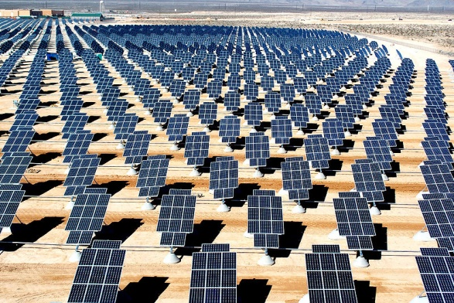
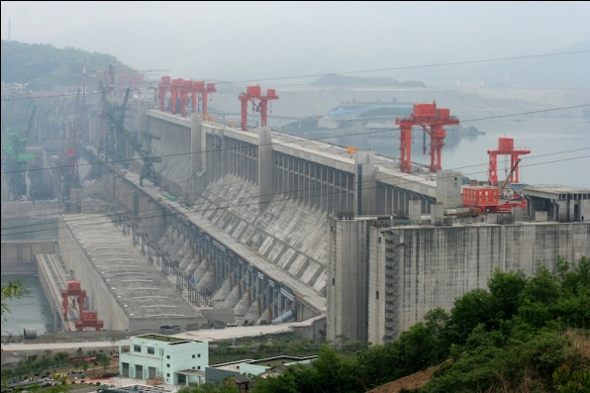
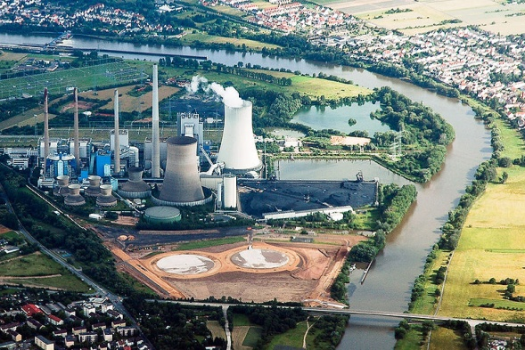
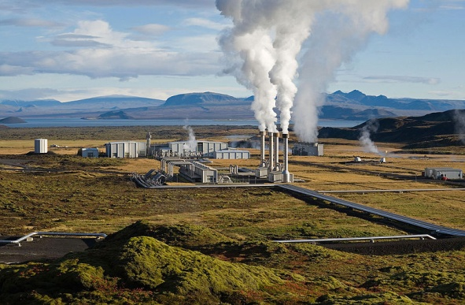
Scaling the power plant
Then people started to build large, centralized power plants with very large capacity...

Slide 53


Metered usage model
Power source
Network
Metering device
Customer
Power plants are connected to customers by a network
Usage is metered, and everyone (basically) pays only for what they actually use

Slide 54

Why is this a good thing?
Electricity
Computing
Economies of scale
Cheaper to run one big power plant than many small ones
Statistical multiplexing
High utilization!
No up-front commitment
No investment in generator; pay-as-you-go model
Scalability
Thousands of kilowatts available on demand; add more within seconds
Cheaper to run one big data center than many small ones
High utilization!
No investment in data center; pay-as-you-go model
Thousands of computers available on demand; add more within seconds

Slide 55

What is cloud computing?
http://geekandpoke.typepad.com/geekandpoke/images/2008/05/16/se17.jpg

Slide 56
What is cloud computing?
The interesting thing about Cloud Computing is that we've redefined Cloud Computing to include everything that we already do.... I don't understand what we would do differently in the light of Cloud Computing other than change the wording of some of our ads. Larry Ellison, quoted in the Wall Street Journal, September 26, 2008
A lot of people are jumping on the [cloud] bandwagon, but I have not heard two people say the same thing about it. There are multiple definitions out there of "the cloud". Andy Isherwood, quoted in ZDnet News, December 11, 2008

Slide 57
So what is it, really?
According to NIST:
Essential characteristics:
On-demand self service
Broad network access
Resource pooling
Rapid elasticity
Measured service
Cloud computing is a model for enabling convenient, on-demand network access to a shared pool of configurable computing resources (e.g., networks, servers, storage, applications, and services) that can be rapidly provisioned and released with minimal management effort or service provider interaction.

Slide 58
Other terms you may have heard
Utility computing
The service being sold by a cloud
Focuses on the business model (pay-as-you-go), similar to classical utility companies
The Web
The Internet’s information sharing model
Some web services run on clouds, but not all
The Internet
A network of networks
Used by the web; connects (most) clouds to their customers

Slide 59
Plan for today
Computing at scale
The need for scalability; scale of current services
Scaling up: From PCs to data centers
Problems with 'classical' scaling techniques
Utility computing and cloud computing
What are utility computing and cloud computing?
Evolution of software business models
What kinds of clouds exist today?
What kinds of applications run on the cloud?
Virtualization: How clouds work 'under the hood'
Some cloud computing challenges
NEXT

Slide 60
Model 1
1
Traditional
$4000/user
(one time)
SW
$800/user/ year
Support
For large software companies (MS, SAP, Oracle) is a good model
Buy perpetual license, and upgrades, bug fixes, phone support
Notes:
BM: you buy the software from Microsoft, Oracle: perpuetual license / upgrade and update and the right to call
derivative price: 20% of the license price
very good business model
very high profit margin
large software companies: that model works really really well
Oracle 12 B out of 15 B

Slide 61
Model 2
1
Traditional
2
Open Source
$4000/user
(one time)
$0/user
SW
$800/user/ year
$1600/user/year
Support
Not as many success stories (biggest one probably RedHat)
But open source is fueling much success for cloud computing
Notes:
conceptually more than in model 1
1 success story: redhat network is one good example of this working
not many other examples of it

Slide 62
Management Costs
1
Traditional
$4000/user
(one time)
SW
$800/user/ year
Support
$16,000/user/year
($1300/user/year)
To manage the security, availability, performance, problems and change
Mgmt
Cost to manage software is 4x the purchase price per year
Notes:
cost of the software does not end with purchase
If I buy a CRM, HR , supply chain, all these applications; then I need to manage the security, availability, performance and change of the software
If you look at the budget of a CIO, 75% of the budget is fully allocated for the next year: all spent doing management
Rule of thumb: people spend 4 times the cost of the software to manage it
16000/user/year

Slide 63
Model 3
1
Traditional
2
Open Source
3
Outsourcing
$4000/user
(one time)
$0/user
$4000/user
(one time)
SW
$800/user/ year
$1600/user/year
$800/user /year
Support
Bid
<1300/user/month
Mgmt
At home / at customer
Outsourcing became popular in the ’90s as Internet got widespread
Cost reduction through low-cost labor is hard to sustain
Human error is #1 cause of computer system failures
Notes:
take over the datacenter or do it at my datacenter
@home or my @datacent
took over in late 90s.
why?
network got in place
2nd: cheap human
fundamental problem with the model: people are not going to work for 1/10th of the cost in another location
another flaw: why do computer system fail? #1 failure source is operator failure

Slide 64
Model 4
1
Traditional
2
Open Source
3
Outsourcing
4
Hybrid
$4000/user
(one time)
$0/user
$4000/user
(one time)
$4000/user
(one time)
SW
$800/user/ year
$1600/user/year
$800/user/ year
$800/user/ year
Support
Bid
<1300/user/month
$150/user/ month
Mgmt
At home / at customer
At home / at customer
How to decrease costs by 10x?
Standardization, specialization, repetition → in time automate
Notes:
manage at my place or your place: for $150 dollars
support: continuing refresh upgrade and right to calls them up: how do I use it? there is a bug and fix it
mgmt: security fixes, patch the reason this hybrid model can work:
standardization, specialization, repetition
standardize the stack: hardware, software (OS), how you manage security patches
then in time you can crush costs

Slide 65
Model 5
1
Traditional
2
Open Source
3
Outsourcing
4
Hybrid
5
Hybrid+
$4000/user
(one time)
$0/user
$4000/user
(one time)
$4000/user
(one time)
$300/user/ month
SW
$800/user/ year
$1600/user/year
$800/user/ year
$800/user/ year
Support
Bid
<1300/user/month
$150/user/ month
Mgmt
At home / at customer
At home / at customer
At home / at customer
Pure subscription model
Simply a change of the payment term compared to Model 4

Slide 66
Model 6
1
Traditional
2
Open Source
3
Outsourcing
4
Hybrid
5
Hybrid+
6
Cloud
$4000/user
(one time)
$0/user
$4000/user
(one time)
$4000/user
(one time)
$300/user/ month
<$100/user/month
SW
$800/user/ year
$1600/user/year
$800/user/ year
$800/user/ year
Support
Bid
<1300/user/month
$150/user/ month
Mgmt
At home / at customer
At home / at customer
At home / at customer
Software companies gone public since 2000 deliver Cloud services
10x cost reduction in exchange for higher degree of standardization
Notes:
delivered as a cloud service
every company that has gone public since 2000 is in model 6
you don't get to pick where it runs, when to patch it
in exchange for higher degree of automation, I can take the cost structure down

Slide 67
Model 7
1
Traditional
2
Open Source
3
Outsourcing
4
Hybrid
5
Hybrid+
6
Cloud
7
Internet
$4000/user
(one time)
$0/user
$4000/user
(one time)
$4000/user
(one time)
$300/user/ month
<$100/user/month
Ads
Transactions
Embedded
(<$10/user/month)
SW
$800/user/ year
$1600/user/year
$800/user/ year
$800/user/ year
Support
Bid
<1300/user/month
$150/user/ month
Mgmt
At home / at customer
At home / at customer
At home / at customer
No direct charge; monetization model is asymmetric
Software is paid through ads, transactions fees, …
Consumer apps have dramatically lower costs than enterprise apps
Notes:
Monetization model is asymmetric
you don't pay directly, you compensate with ads
most companies started in the past 10 years are in the 6th or 7th model
for business applications, the growth is happening in model 6

Slide 68
Cloud computing is a business model
AWS
us-west-2
prices
Compute
Per service hour
$0.16/hour
(averaged on instance sizes)
Storage
Per GB stored
SSD: $0.10 HDD: $0.05
GB/month

Slide 69
Plan for today
Computing at scale
The need for scalability; scale of current services
Scaling up: From PCs to data centers
Problems with 'classical' scaling techniques
Utility computing and cloud computing
What are utility computing and cloud computing?
Evolution of software business models
What kinds of clouds exist today?
What kinds of applications run on the cloud?
Virtualization: How clouds work 'under the hood'
Some cloud computing challenges
NEXT

Slide 70
Everything as a Service
What kind of service does the cloud provide?
Does it offer an entire application, or just resources?
If resources, what kind / level of abstraction?
Three types commonly distinguished:
Software as a service (SaaS)
Analogy: Restaurant. Prepares&serves entire meal, does the dishes, ...
Platform as a service (PaaS)
Analogy: Take-out food. Prepares meal, but does not serve it.
Infrastructure as a service (IaaS)
Analogy: Grocery store. Provides raw ingredients.
Other *aaS types have been defined, but are less common
Desktop, Backend, Communication, Network, Monitoring, ...

Slide 71




Software as a Service (SaaS)
User
Application
Middleware
Hardware
Cloud provider
Cloud provides an entire application
Word processor, spreadsheet, CRM software, calendar...
Customer pays cloud provider
Example: Google Apps, Salesforce.com, Concur, Doodle

Slide 72



Platform as a Service (PaaS)
SaaS provider
User
Application
Middleware
Hardware
Cloud provider
Cloud provides middleware/infrastructure
For example, Microsoft Common Language Runtime (CLR)
Customer pays SaaS provider for the service; SaaS provider pays the cloud for the infrastructure
Example: Windows Azure, Google App Engine, Heroku

Slide 73

Infrastructure as a Service (IaaS)
SaaS provider
User
Application
Middleware
Hardware
Cloud provider
Cloud provides raw computing resources
Virtual machine, blade server, storage, network, ...
Customer pays SaaS provider for the service; SaaS provider pays the cloud for the resources
Examples: Amazon Web Services, DigitalOcean, Joyent

Slide 74





Private/hybrid/community clouds
Company A
Company B
Public
Community
Private
Who can become a customer of the cloud?
Public cloud: Commercial service; open to (almost) anyone. Example: Amazon AWS, Microsoft Azure, Google App Engine
Community cloud: Shared by several similar organizations. Example: Google’s “Gov Cloud”
Private cloud: Shared within a single organization. Example: Internal datacenter of a large company.
Focus of this course

Slide 75
Plan for today
Computing at scale
The need for scalability; scale of current services
Scaling up: From PCs to data centers
Problems with 'classical' scaling techniques
Utility computing and cloud computing
What are utility computing and cloud computing?
Evolution of software business models
What kinds of clouds exist today?
What kinds of applications run on the cloud?
Virtualization: How clouds work 'under the hood'
Some cloud computing challenges
NEXT

Slide 76
Examples of cloud applications
Application hosting
Backup and Storage
Content delivery
E-commerce
High-performance computing
Media hosting
On-demand workforce
Search engines
Web hosting
If interested, glance through http://aws.amazon.com/solutions/case-studies/ for a list of many use cases

Slide 77


Case study:
Animoto: Lets users create videos from their own photos/music
Auto-edits photos and aligns them with the music, so it "looks good"
Built using Amazon EC2+S3+SQS
Released a Facebook app in mid-April 2008
More than 750,000 people signed up within 3 days
EC2 usage went from 50 machines to 3,500 (x70 scalability!)
http://animoto.com/blog/company/amazon-com-ceo-jeff-bezos-on-animoto/
Source: Jeff Bezos' talk at Stanford on 4/19/08
http://aws.amazon.com/solutions/case-studies/animoto/

Slide 78

Case study:
Novartis Institutes for Biomedical Research is focused on the drug discovery phase of the ~10 year / $1 billion drug development process
In 2013, NIBR ran a project to screen 10 M compounds against a common cancer target
Compute requirements >> internal capacity / $
The project ran across 10,500 EC2 Spot instances (~87,000 cores) for $4,232 in 9 hours
Equiv. of 39 years of computational chemistry
http://aws.amazon.com/solutions/case-studies/novartis/

Slide 79



Other examples
DreamWorks is using the Cerelink cloud to render animation movies
Cloud was already used to render parts of Shrek Forever After and How to Train your Dragon
CERN is working on a "science cloud" to process experimental data
Virgin atlantic is hosting their new travel portal on Amazon AWS

Slide 80
Recap: Utility/cloud computing
Why is cloud computing attractive?
Analogy to 'classical' utilities (electricity, water, ...)
No up-front investment (pay-as-you-go model)
Low price due to economies of scale
Elasticity - can quickly scale up/down as demand varies
Different types of clouds
SaaS, PaaS, IaaS; public/private/community clouds
What runs on the cloud?
Many potential applications: Application hosting, backup/storage, scientific computing, content delivery, ...
Not yet suitable for certain applications (sensitive data, compliance requirements)

Slide 81
Is the cloud good for everything?
No.
Sometimes it is problematic
Auditability requirements
Legislative frameworks
Example: Personal data privacy
EU Data Protection law
Example: Processing medical records (US)
HIPAA (Health Insurance Portability and Accountability Act) privacy and security rule

Slide 82
Recap: Cloud applications
Clouds are good for many things...
Applications that involve large amounts of computation, storage, bandwidth
Especially when lots of resources are needed quickly (Novartis example) or load varies rapidly (Animoto example)
... but not for all things
and might not be the cheapest solution either

Slide 83
Plan for today
Computing at scale
The need for scalability; scale of current services
Scaling up: From PCs to data centers
Problems with 'classical' scaling techniques
Utility computing and cloud computing
What are utility computing and cloud computing?
Evolution of software business models
What kinds of clouds exist today?
What kinds of applications run on the cloud?
Virtualization: How clouds work 'under the hood'
Some cloud computing challenges
NEXT

Slide 84




What is virtualization?
Bob
Charlie
Alice
Physical machine
Daniel
Suppose Alice has a machine with 4 CPUs and 8 GB of memory, and three customers:
Bob wants a machine with 1 CPU and 3GB of memory
Charlie wants 2 CPUs and 1GB of memory
Daniel wants 1 CPU and 4GB of memory
What should Alice do?

Slide 85




What is virtualization?
Bob
Virtual machine monitor
Charlie
Alice
Physical machine
Virtual machines
Daniel
Alice can sell each customer a virtual machine (VM) with the requested resources
From each customer’s perspective, it appears as if they had a physical machine all by themselves (isolation)

Slide 86

How does it work?
App
VM 1
VM 2
VM | Virt | Phys
1 | 0-99 | 0-99
1 | 299-399 | 100-199
2 | 0-99 | 300-399
2 | 200-299 | 500-599
2 | 600-699 | 400-499
App
App
OS 1
OS 2
VMM
Translation table
Physical machine
Resources (CPU, memory, ...) are virtualized
VMM ("Hypervisor") has translation tables that map requests for virtual resources to physical resources
Example: VM 1 accesses memory cell #323; VMM maps this to memory cell 123.
For which resources does this (not) work?
How do VMMs differ from OS kernels?

Slide 87

Benefit: Migration
Bob
Virtual machine monitor
Alice
Charlie
Virtual machines
Daniel
Physical machines
What if the machine needs to be shut down?
e.g., for maintenance, consolidation, ...
Alice can migrate the VMs to different physical machines without any customers noticing

Slide 88
Benefit: Time sharing
Emil
Bob
Virtual machine monitor
Charlie
Alice
Physical machine
Virtual machines
Daniel
What if Alice gets another customer?
Multiple VMs can time-share the existing resources
Oversubscription: Alice has more virtual CPUs and virtual memory than physical resources (but not all can be active at the same time)

Slide 89






Benefit and challenge: Isolation
Emil
Bob
VMM
Charlie
Alice
Physical machine
Virtual machines
Daniel
Good: Emil can't access Charlie's data
Bad: What if the load suddenly increases?
Example: Emil's VM shares CPUs with Charlie's VM, and Charlie suddenly starts a large compute job
Emil's performance may decrease as a result
VMM can move Emil's software to a different CPU, or migrate it to a different machine

Slide 90
Recap: Virtualization in the cloud
Gives cloud provider a lot of flexibility
Can produce VMs with different capabilities
Can migrate VMs if necessary (e.g., for maintenance)
Can increase load by overcommitting resources
Provides security and isolation
Programs in one VM cannot influence programs in another
Convenient for users
Complete control over the virtual 'hardware' (can install own operating system own applications, ...)
But: Performance may be hard to predict
Load changes in other VMs on the same physical machine may affect the performance seen by the customer

Slide 91
Plan for today
Computing at scale
The need for scalability; scale of current services
Scaling up: From PCs to data centers
Problems with 'classical' scaling techniques
Utility computing and cloud computing
What are utility computing and cloud computing?
Evolution of software business models
What kinds of clouds exist today?
What kinds of applications run on the cloud?
Virtualization: How clouds work 'under the hood'
Some cloud computing challenges
NEXT

Slide 92
10 obstacles and opportunities
Availability
What happens to my business if there is an outage in the cloud?
Data lock-in
How do I move my data from one cloud to another?
Data confidentiality and auditability
How do I make sure that the cloud doesn't leak my confidential data?
Can I comply with regulations?
Service | Duration | Date
S3 | 6-8 hrs | 7/20/08
AppEngine | 5 hrs | 6/17/08
Gmail | 1.5 hrs | 8/11/08
Azure | 22 hrs | 3/13/09
Intuit | 36 hrs | 6/16/10
EBS | >3 days | 4/21/11
ECC | ~2 hrs | 6/30/12
Some recent cloud outages

Slide 93
10 obstacles and opportunities
Data transfer bottlenecks
How do I copy large amounts of data from/to the cloud?
Example: 10 TB from UC Berkeley to Amazon in Seattle, WA
Motivated Import/Export feature on AWS
Performance unpredictability
Example: VMs sharing the same disk → I/O interference
Example: HPC tasks that require coordinated scheduling
Method | Time
Internet (20Mbps)
FedEx
45 days
1 day
Time to transfer 10TB [AF10]
Primitive | Mean perf. | Std dev
Memory bandwidth | 1.3GB/s | 0.05GB/s (4%)
Disk bandwidth | 55MB/s | 9MB/s (16%)
Performance of 75 EC2 instances in benchmarks

Slide 94
10 obstacles and opportunities
Scalable storage
Cloud model (short-term usage, no up-front cost, infinite capacity on demand) does not fit persistent storage well
Bugs in large distributed systems
Many errors cannot be reproduced in smaller configs
Scaling quickly
Problem: Boot time; idle power
Fine-grain accounting?

Slide 95
10 obstacles and opportunities
Reputation fate sharing
One customer's bad behavior can affect the reputation of others using the same cloud
Example: Spam blacklisting, FBI raid after criminal activity
Software licensing
What if licenses are for specific computers?
Example: Microsoft Windows
How to scale number of licenses up/down?
Need pay-as-you-go model as well

Slide 96
Plan for today
Scalable computing
The need for scalability; scale of current services
Scaling up: From PCs to data centers
Problems with 'classical' scaling techniques
Utility computing and cloud computing
What are utility computing and cloud computing?
Evolution of software business models
What kinds of clouds exist today?
What kinds of applications run on the cloud?
Virtualization: How clouds work 'under the hood'
Some cloud computing challenges

Slide 97
Any questions?

Slide 98

Stay tuned
http://www.flickr.com/photos/10909957@N03/3135455311/
Next time you will learn about: Design for large scale; Concurrency, consistency, fault tolerance

